Slide 1
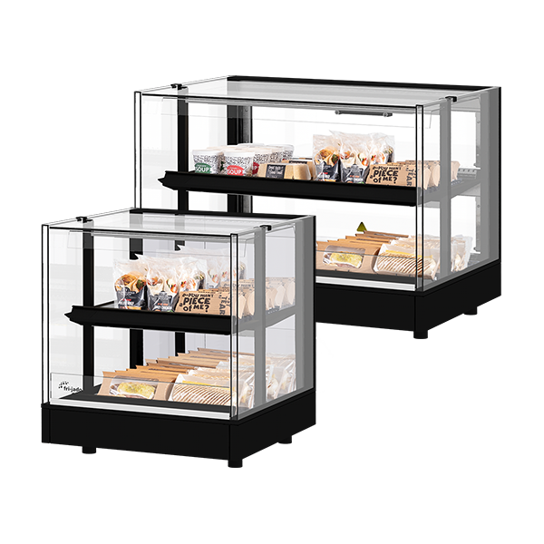
MDD Hot The Hot Food Display Cabinet
Without Compromises
Fri-Jado Hot Table Top Display MTT

Slide 2
Fri-Jado Table Top Display MTT: The compact plug & play solution for hot and packaged food to go.

Slide 3
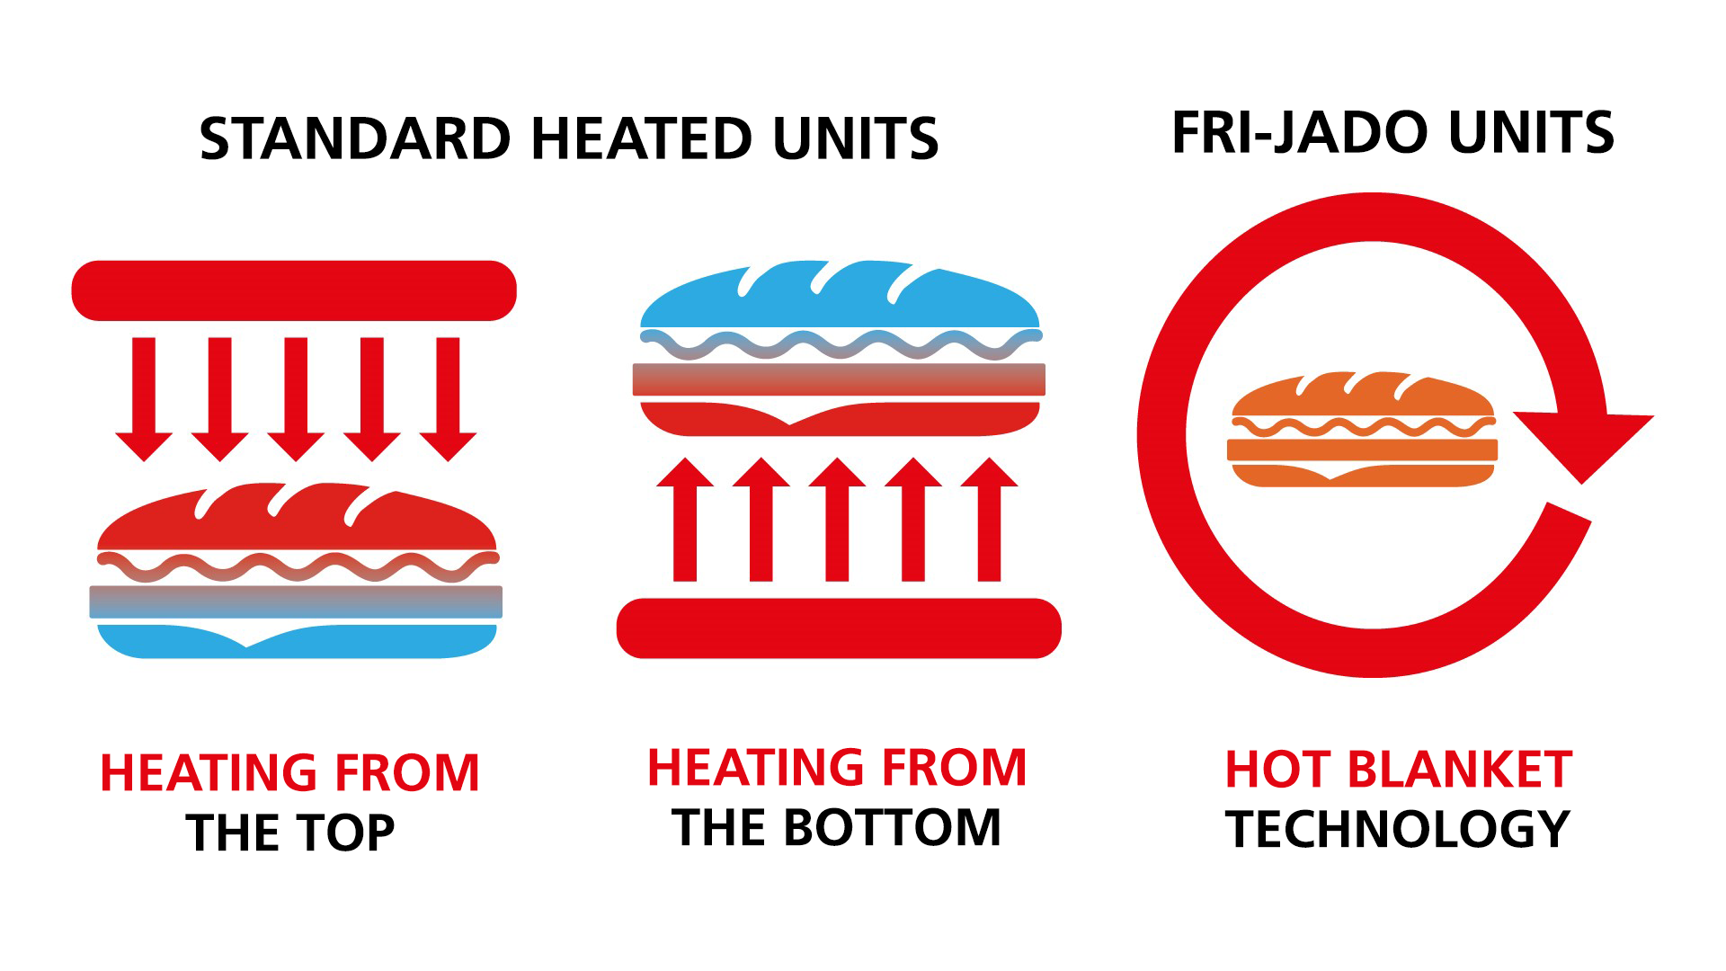
Fri-Jado MTT
Features & Benefits
Transparent design
All eyes on your food
Premium Hot Blanket Holding Technology - Hot air recirculation per shelf + mild shelf heating fully encloses your products
Extends product shelf life, up to 50% energy savings
Multi Temp – individual shelf temperature settings
Holds food from different food groups in one unit
Compact solution
Can be put on existing countertops
Plug & play
No installation effort

Slide 4
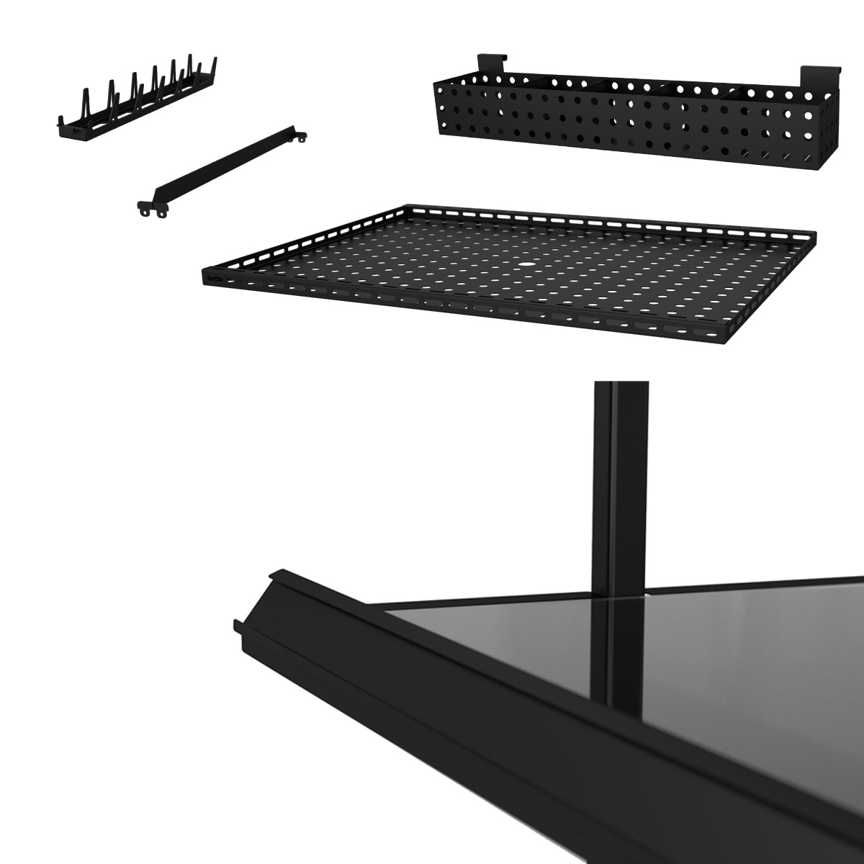
Fri-Jado MTT
Product information
Heated display for packaged food-to-go
2 levels, 600 or 900 mm wide
With solid back or folding rear doors
Adjustable top shelf angle
LED shelf lighting
Individual shelf temperature settings between 40°C and 70°C (Multi Temp)
Accessories available to enhance food quality & presentation: - Price rail set - Shelf insert tray - Merchandising rack - Shelf divider - Condiment holder

Slide 5
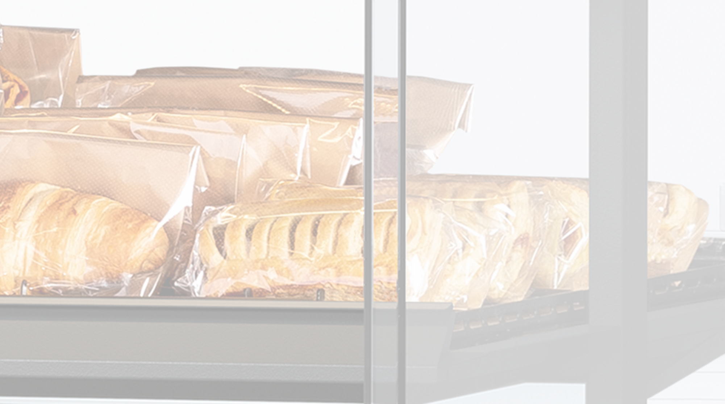
frijado.com

